Slide 1
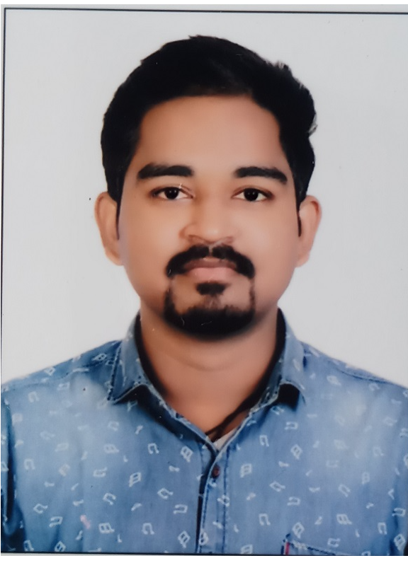



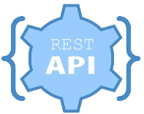
Akash Gaikwad
Professional Experience: Java, MySQL
Responsibilities Handling Capacity
1.5 years of experience in the IT industry with Back-end and development experience along with Java, Sp . Experience in Hibernate, Spring boot, GIT, Relational Mapping tool – Hibernate and Database- MySQL. (SQLyog), Tomcat 8.0 as webserver.
Experience developing application using Java/J2EE, Spring Boot, Hibernate, Maven.
Experience of testing on Swagger and Postman API.
Having the knowledge in Web services protocols like REST.
Completing project concepts and maintain optimal workflow.
Working closely with other developers and development of project as per client needs.
Key Technical and Professional Expertise
Continuous improvement as per client needs.
Worked on tools such as Postman, Swagger for API testing.
Agile methodology of working.
Understanding of basics of Microservices.
Other Technical and Professional Expertise
Good at putting team efforts together and co-ordination to achieve the goal.
Good listener.
Have self-initiated, voluntary learning attitude with more focus on maintaining high level of consistency throughout the task.

